Slide 1
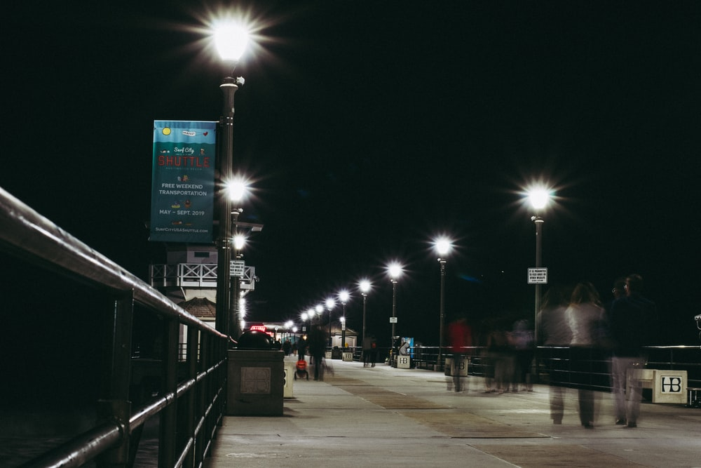
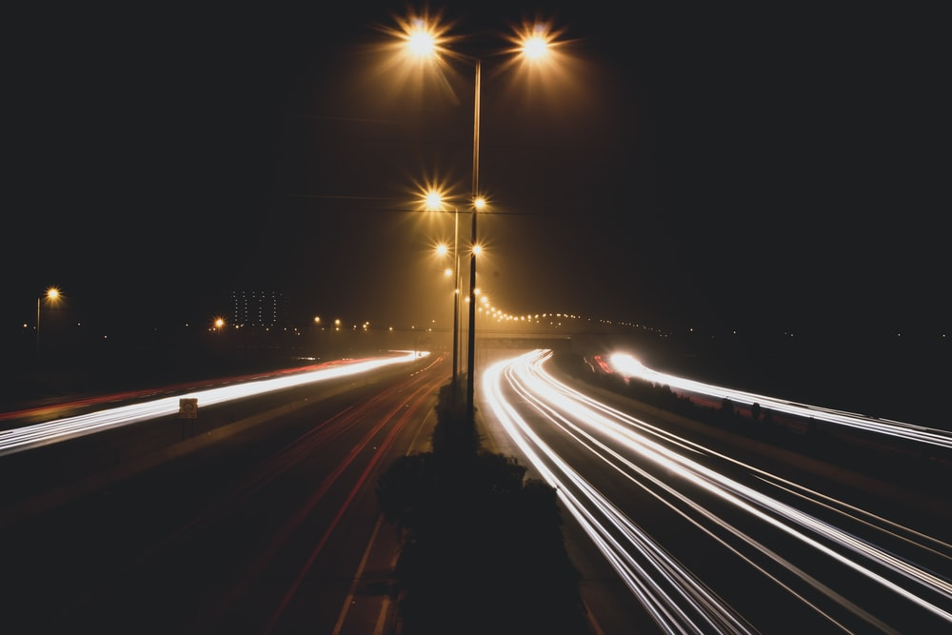
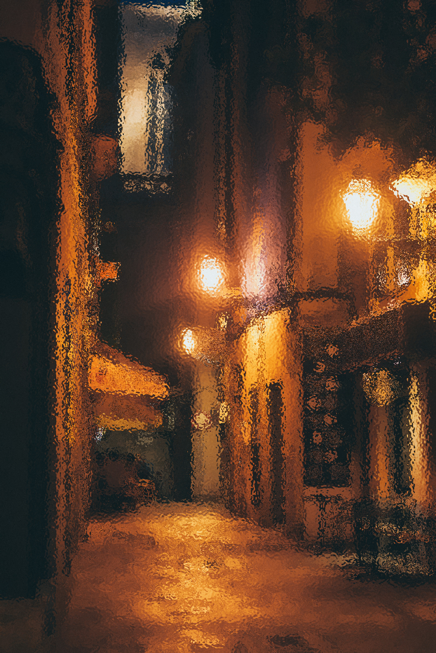
Design Idea for Dimly Lit Roads in India
Project in Design Thinking Laboratory

Slide 2
Contents
01
02
03
04
05
06
Introduction and Problem Statement
Idea Rack
Working and Calculations
Merits and Demerits
Conclusion and Bibliography
Materials and Components

Slide 3

Introduction
Devanshu Surana

Slide 4
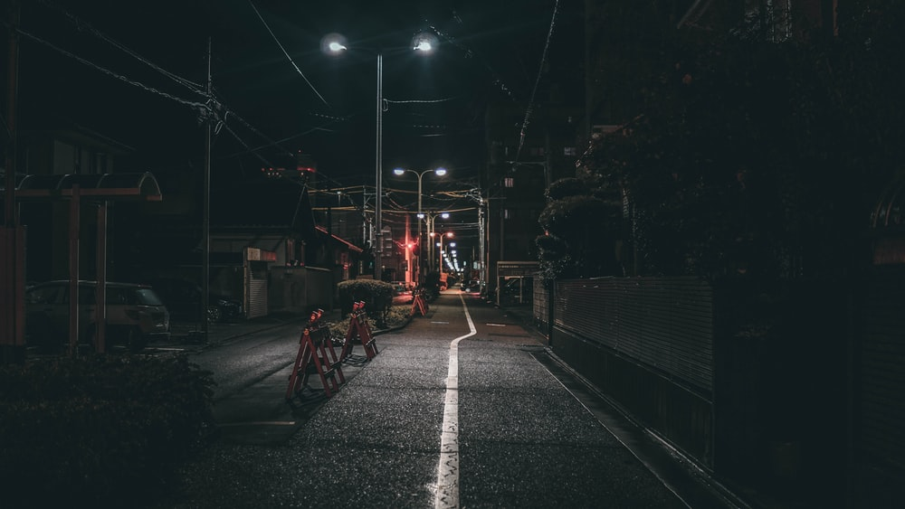
In this Project, we will try to solve the Problem of Dimly Lit Roads in India and any other Part of the world, with the Intention of Generating Renewable Clean Electrical Energy that can be supplied to street Lights. We will Look over some of the alternate Solutions that were brought up as part of the General discussion as part of this Activity. We will see why Some of those ideas worked and others did not.
We will then look at the Proposed Design, the Materials Used in said design, and its prototypes, Sketches and Diagrams. It’s Estimated Energy Generation will be discussed along with the Best case and Worst Case Scenario, which will correspond to weather or not there is a Profit Margin.
Its Potential Merits, Demerits and Learning Experiences will be discussed as well along with the Environmental Impacts

Slide 5
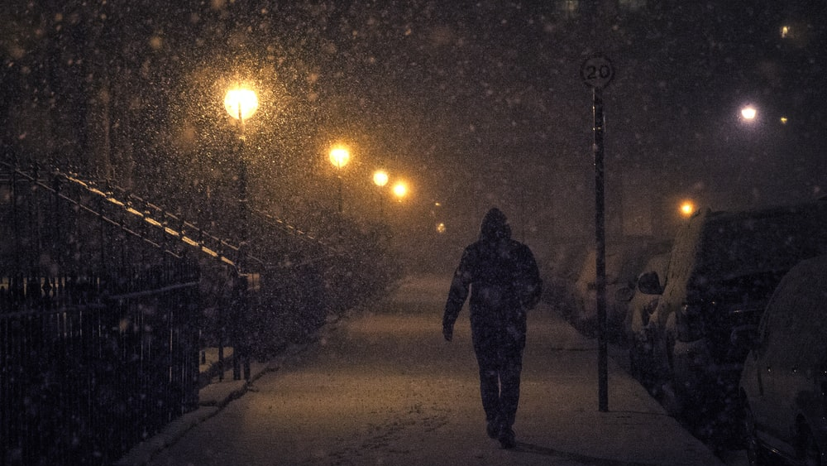
Problem STatement
"Many Roads in India and Other Parts of the World are Dimly Lit because of Absence of Electricity for Street Lights"
While City Corporations claim that more than 90 Percent of the conventional street lights in the city have been converted into LED lights to provide better illumination, several roads in the city still remain pitch dark. Even the arterial roads including VOC Road near the Central bus stand lack adequate streetlights and the existing streetlights are defunct posing a danger to people, particularly working women.
As per the best lighting practices suggested by the Bureau of Energy Efficiency (BEE), the spacing between two successive streetlight poles should not exceed 25 metres. However, the streetlights on VOC Road are installed at a distance of 70 metres.
Many Working Women and men have to use these roads to Walk Home or Travel Home Every single Night, and this has led to a widespread Fear among them.
So this problem is not only an Electricity and development one, it is also one of safety and Security of Our citizens.

Slide 6
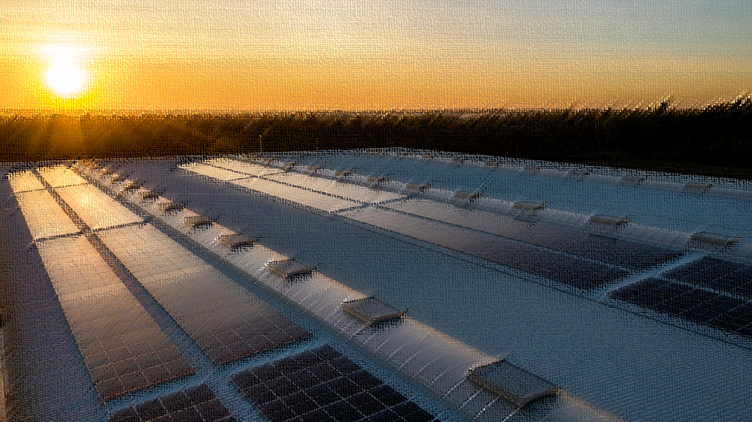
Idea Rack
1. Solar Panels On the top of street lights 2. Tiles or Roads paved with Flywheels for electricity Generation 3. Wind Turbines near the roads. 4. Piezo Electricty from Speed Breakers.

Slide 7

Selected Idea
Tiles or Roads paved with Flywheels for electricity Generation
This Idea has the Potential to work Because: 1. It does not depend on Cars. 2. Electricity can be stored in Batteries below the Street Lights. 3. Tiles can be installed Slowly, and can thereby be installed according to available Budget and Cost.

Slide 8
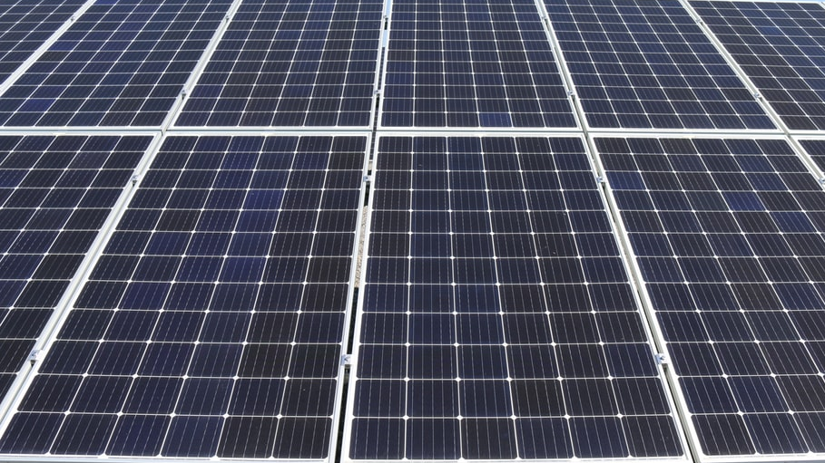
Why Other Ideas were Rejected
Idea 1 Solar Panels On the top of street lights This Idea may not work because - 1. Installation of Solar Panels is Costly 2. Sunlight may not be available in enough amounts throughout the Year. 3. Buildings and Shadows May block Sunlight.

Slide 9
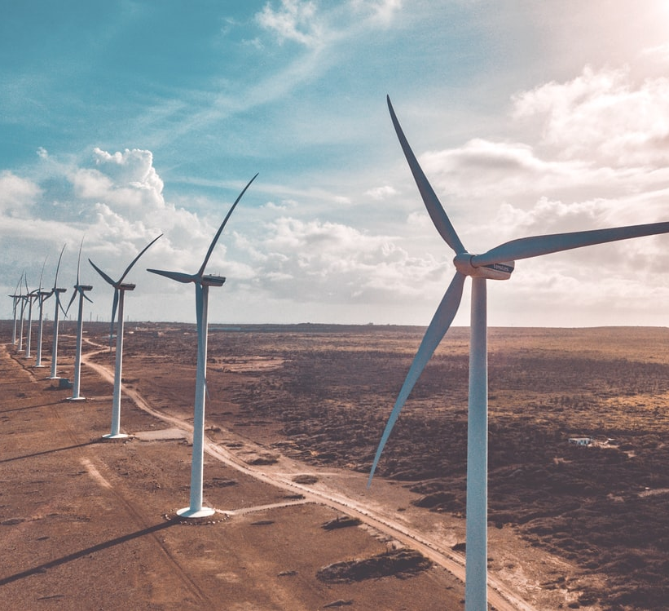
Idea 2
Wind Turbines near the roads. This Idea may not work because- 1. Installation of Wind Turbines is costly 2. Wind may not be available throughout the Year 3. Nearby Buildings may Block the Wind 4. Wind Turbines are Huge and they require more space

Slide 10
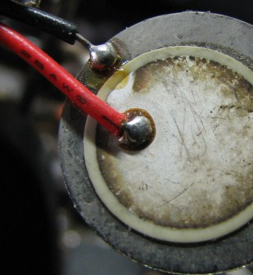
Idea 3
Piezo Electricty in Speed Breakers. This Idea may not work because- 1. Not All roads have cars that pass through them every day. 2. A Human’s Weight is not enough to create the Pressure needed to power the Piezo-Electric Batteries. 3. Maintenance is Difficult

Slide 11
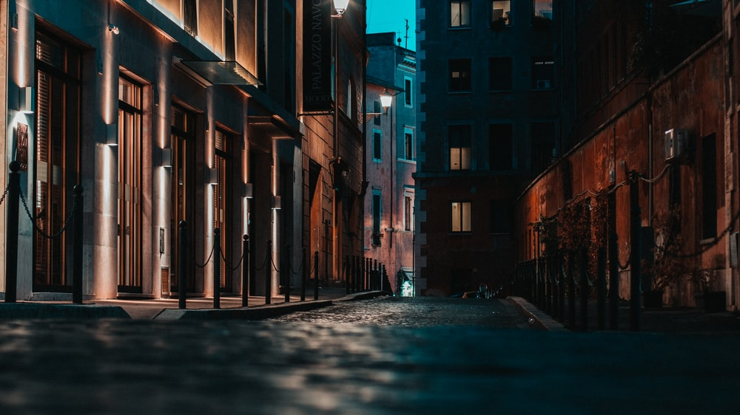
Working and Calculations
Krishnaraj Thadesar

Slide 12
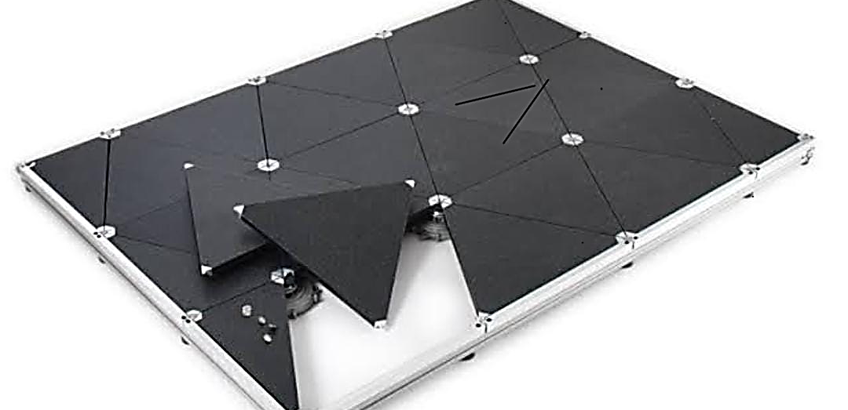
How Tiles Would Look like Tiles

Slide 13
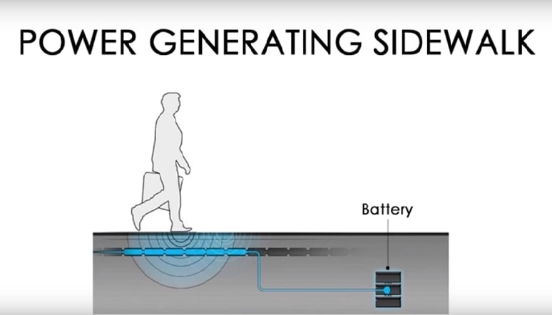

Slide 14
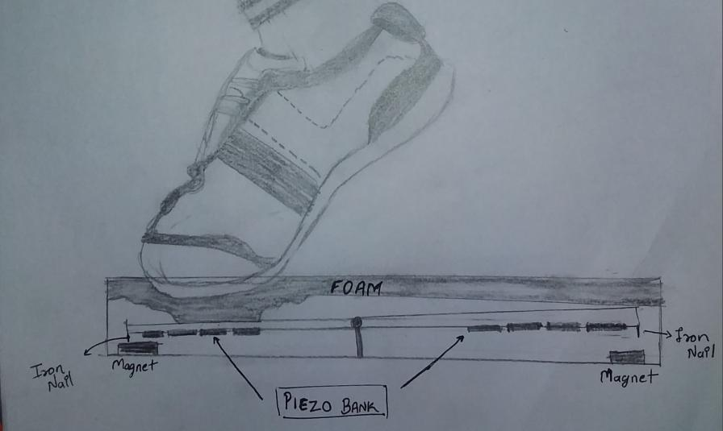
Courtesy: Tirth Thesiya

Slide 15
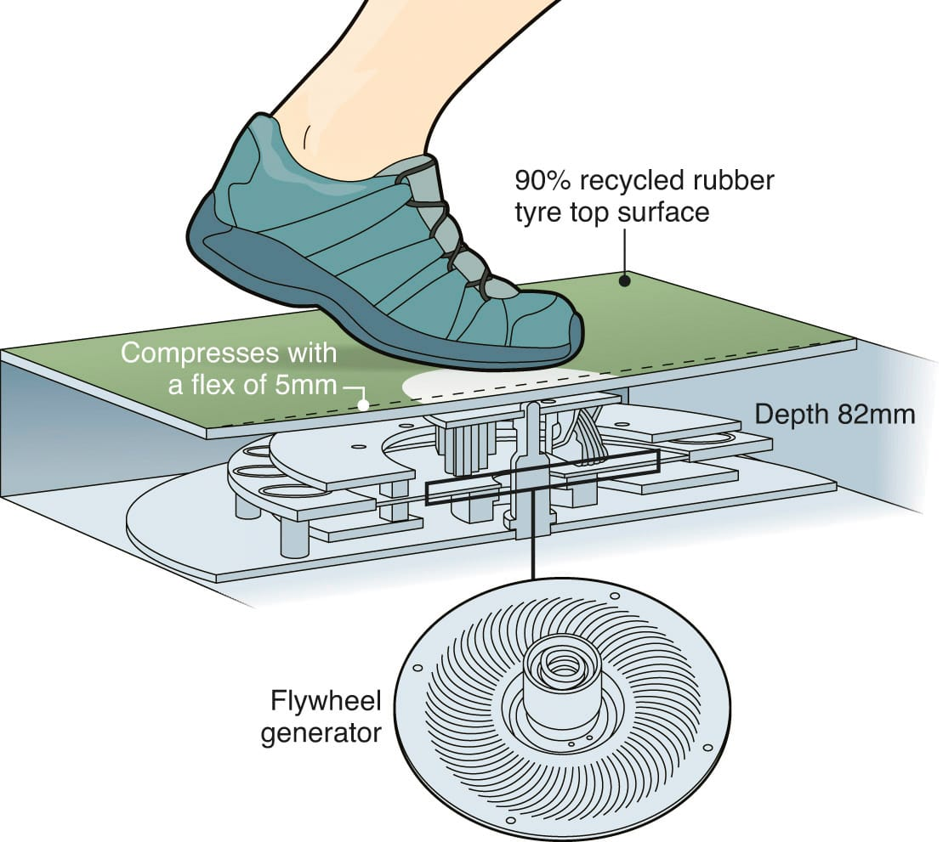

Slide 16
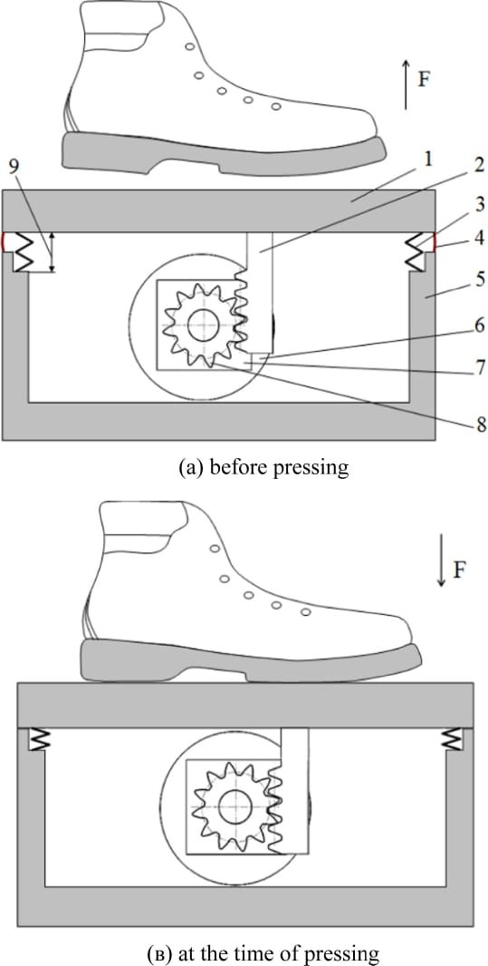

Slide 17
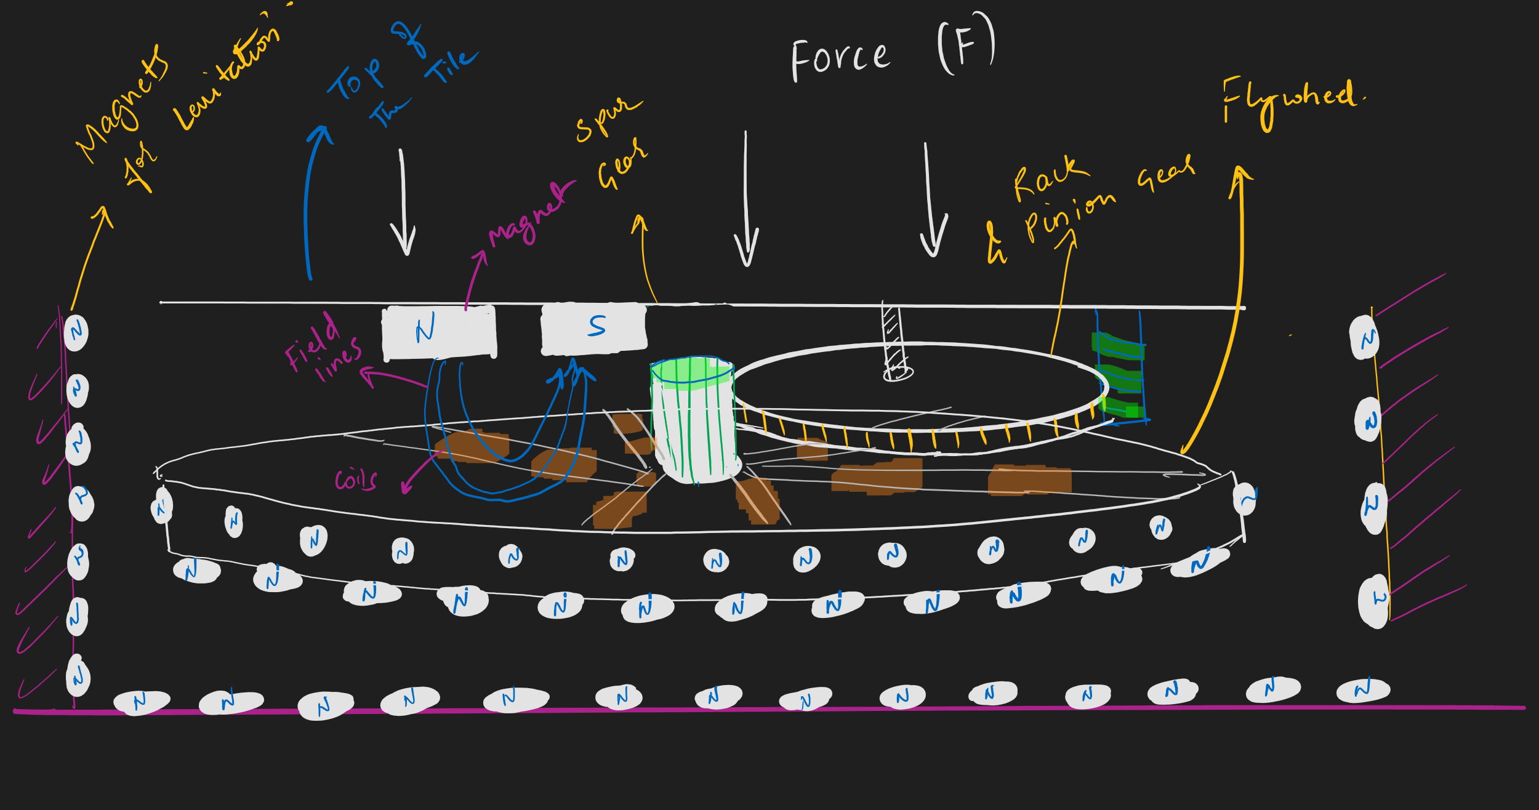

Slide 18
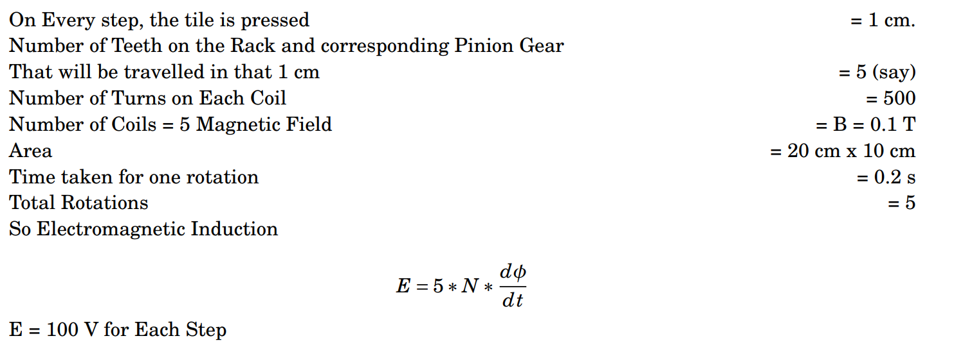
Calculations

Slide 19
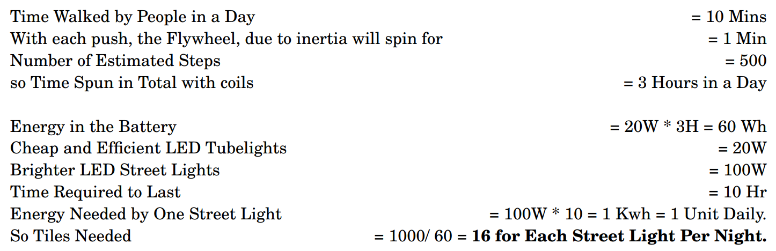

Slide 20
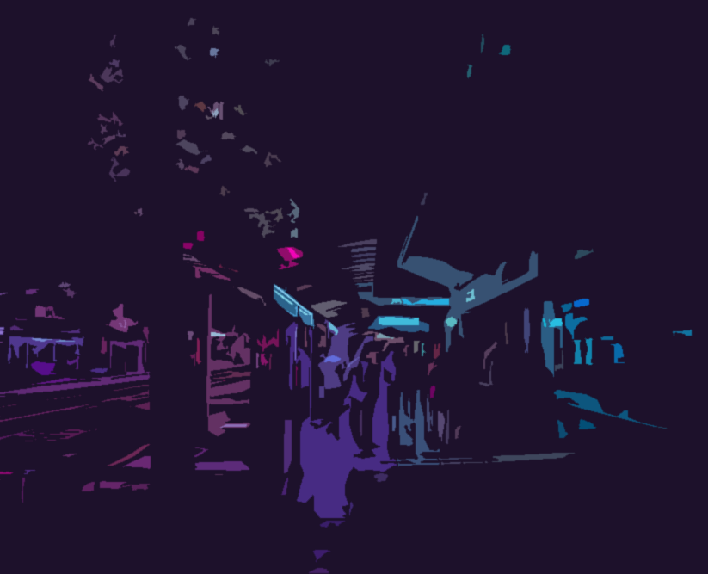
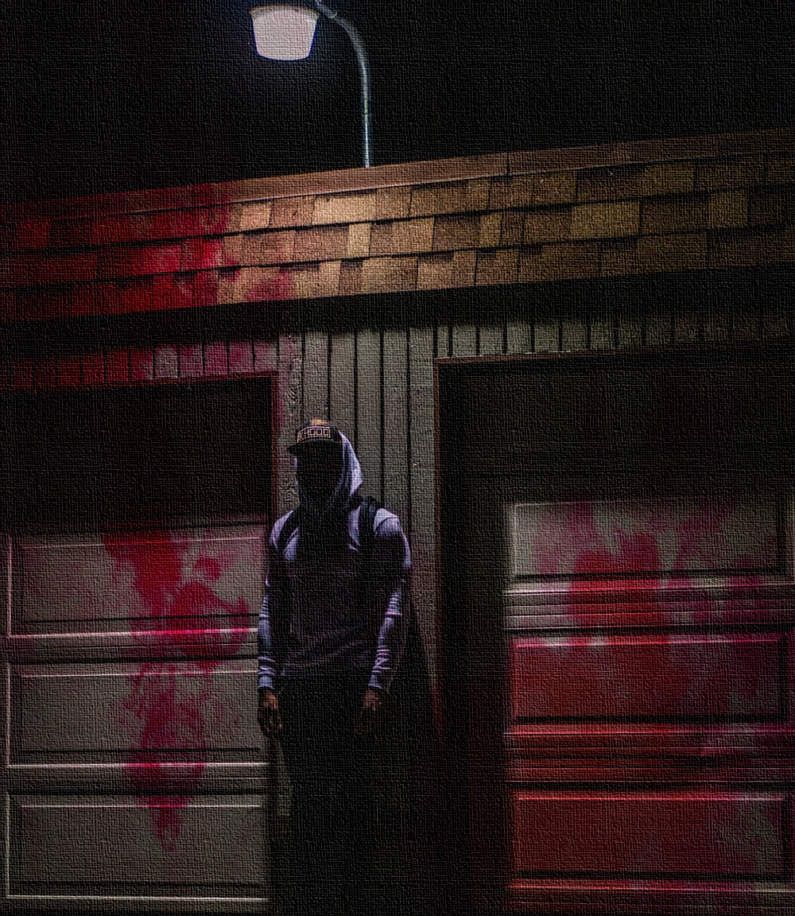
Merits and Demerits
Tirth Thesiya

Slide 21

Merits
1. Environment Friendly 2. Controls Climate pollution and global warming 3. Streets wont be dimly lit, and so will be safer and prevent crimes. 4. Cost Efficient 5. Will make use of the Energy expended by vehicles and people walking. 6. Recycling materials

Slide 22
Rooms for Improvement
Reduce Resistance in Circuit and Wires to Increase Power
Increase number of coils to increase EMF Generated.
Use more Efficient LED Lights.
Disadvantages may include Maintenance due to Delicate Electric Components

Slide 23
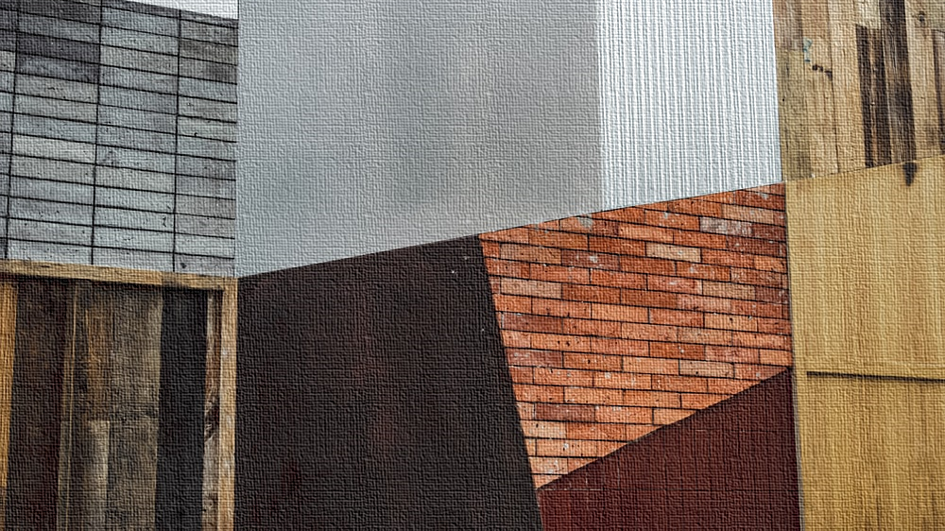
Materials and Components
Pranaav Suratwala

Slide 24
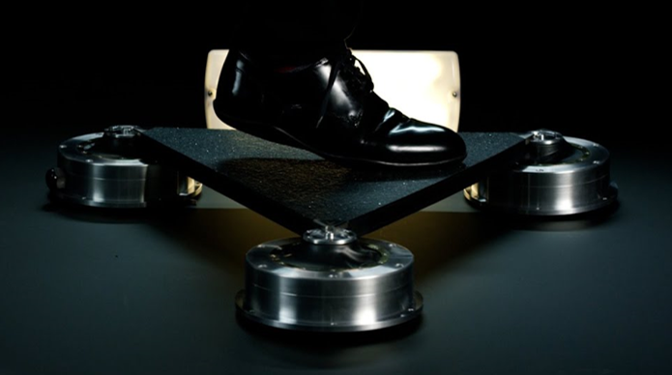
Materials
The tiles are made from nearly 100-percent recycled materials (mostly rubber) and some marine grade stainless steel. They can be retrofitted to existing structures and are waterproof as well as designed to withstand outdoor conditions. The tiles are completely waterproof, so they can endure rain, snow, and ice. Tiles are made from recycled polymer, with the top surface made from recycled truck tires.

Slide 25
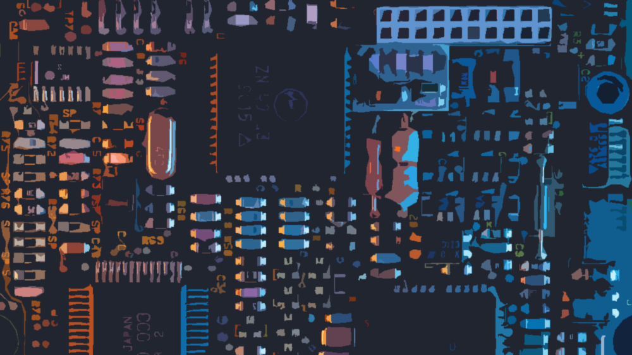
Components

Slide 26
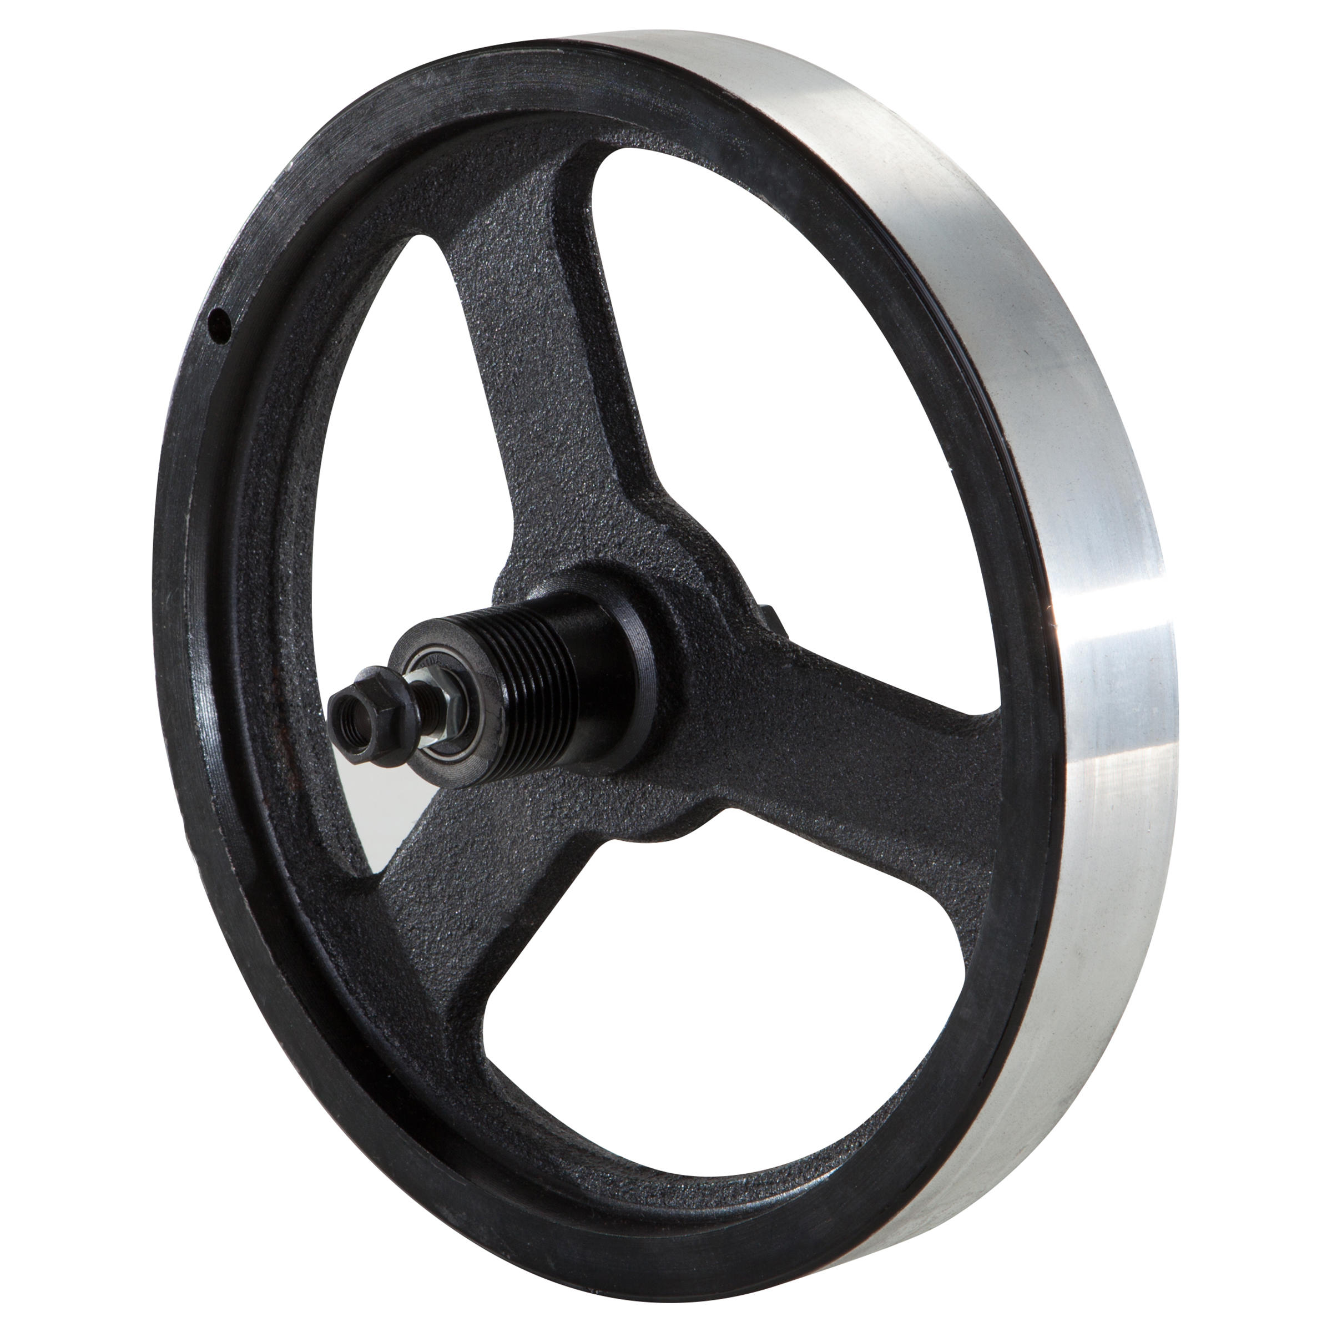
Heavy Metal Flywheel

Slide 27
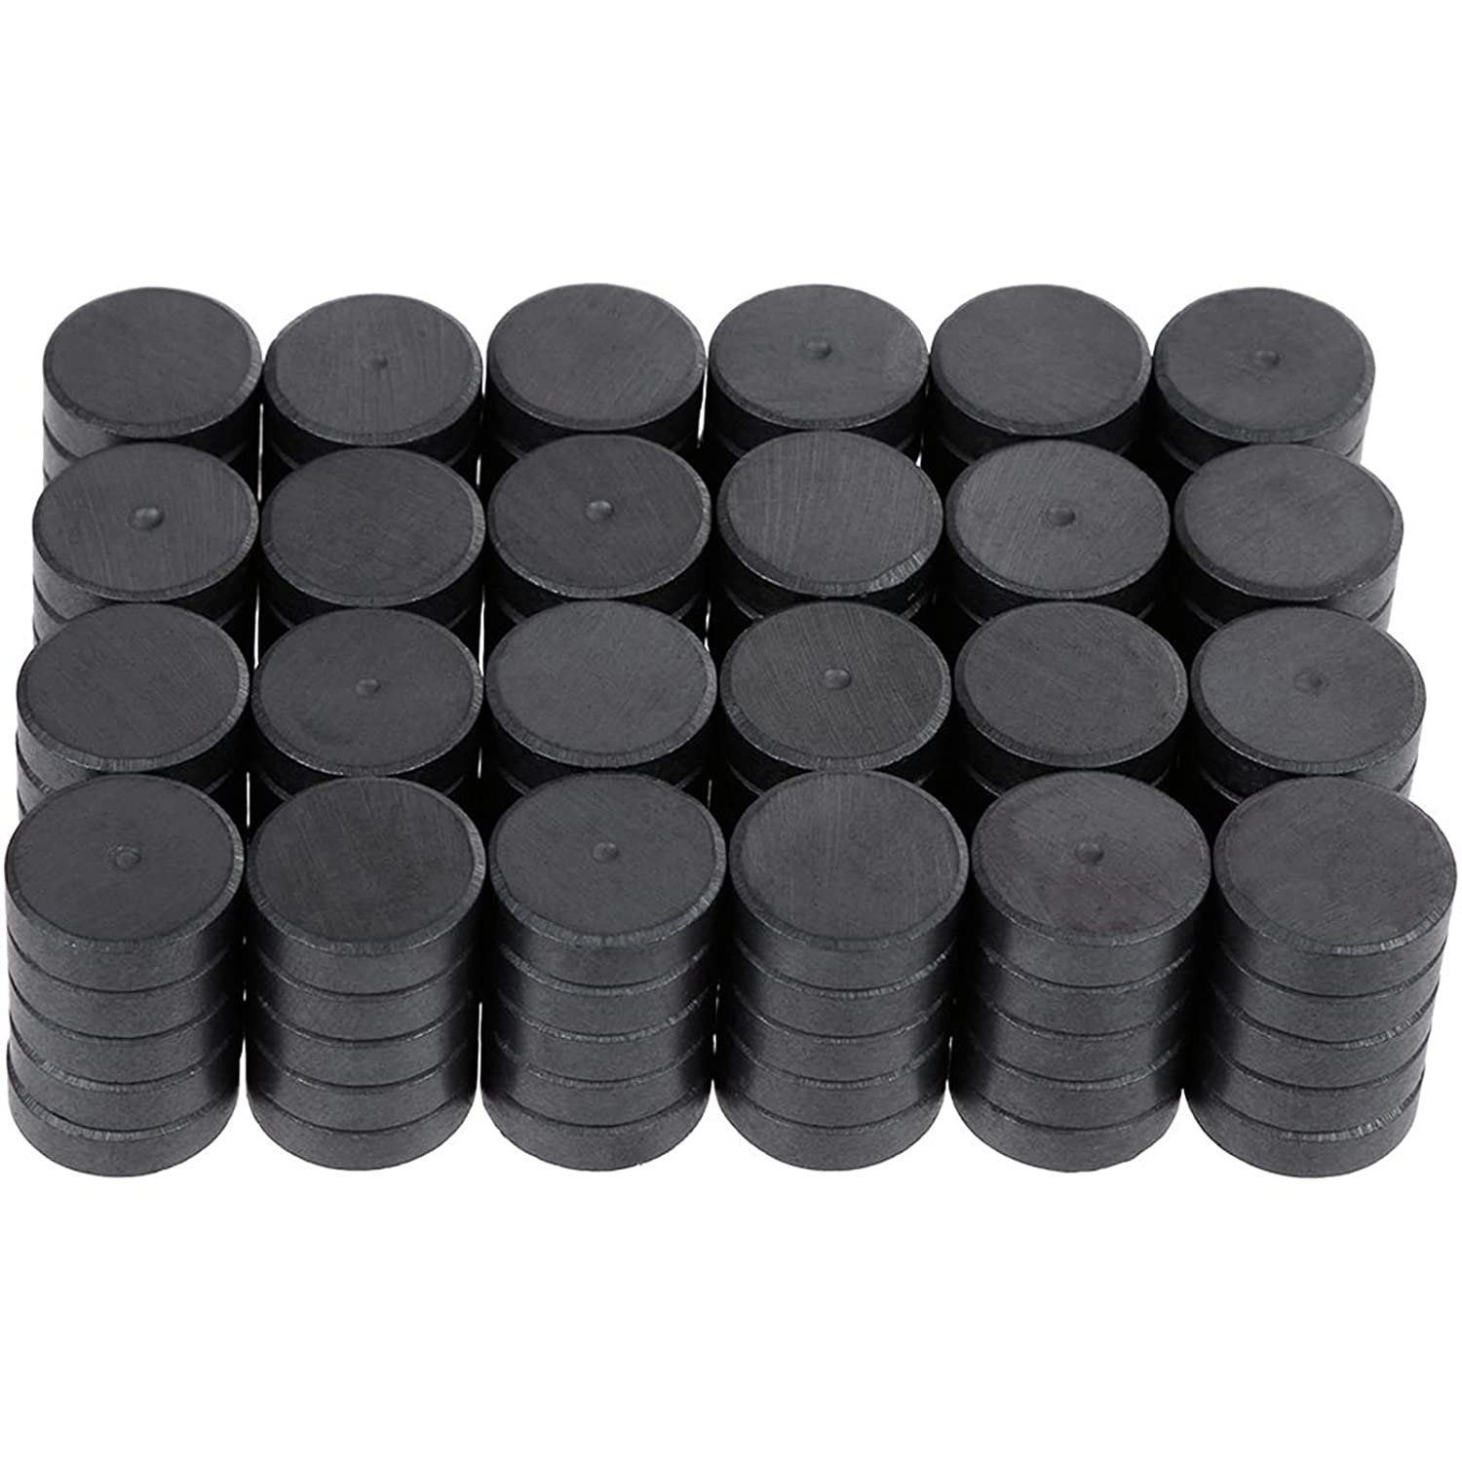
Magnets

Slide 28
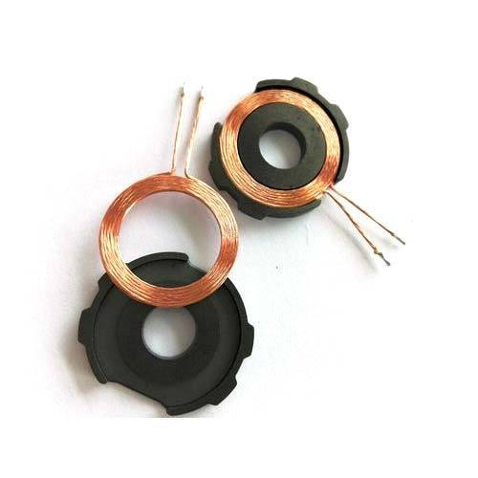
Coils

Slide 29
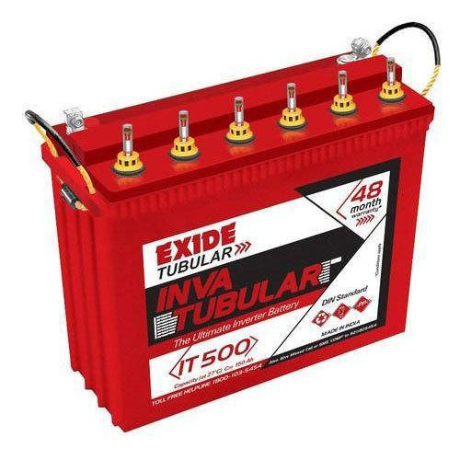
Battery

Slide 30
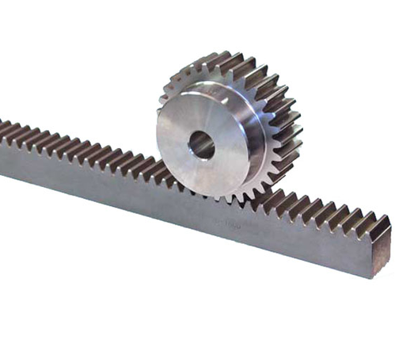
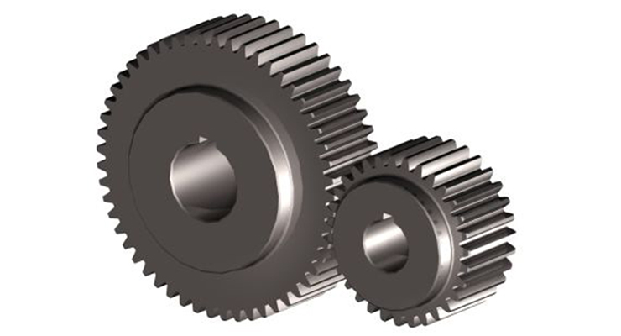
Gears

Slide 31
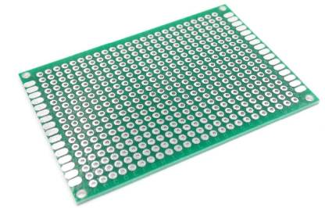
Circuit Board

Slide 32
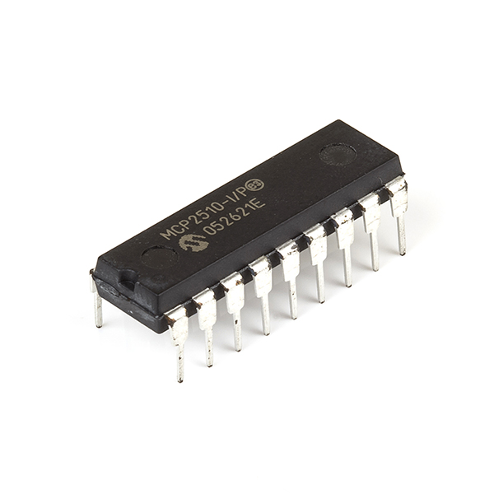
Controller IC

Slide 33
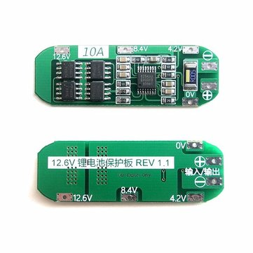
Protection IC

Slide 34
Pricing
These tiles, from manufacturing to installation should costs about 5000 Rs -12000 Rs per square foot. With more localization these tiles would be cheaper and accessible in rural areas.

Slide 35
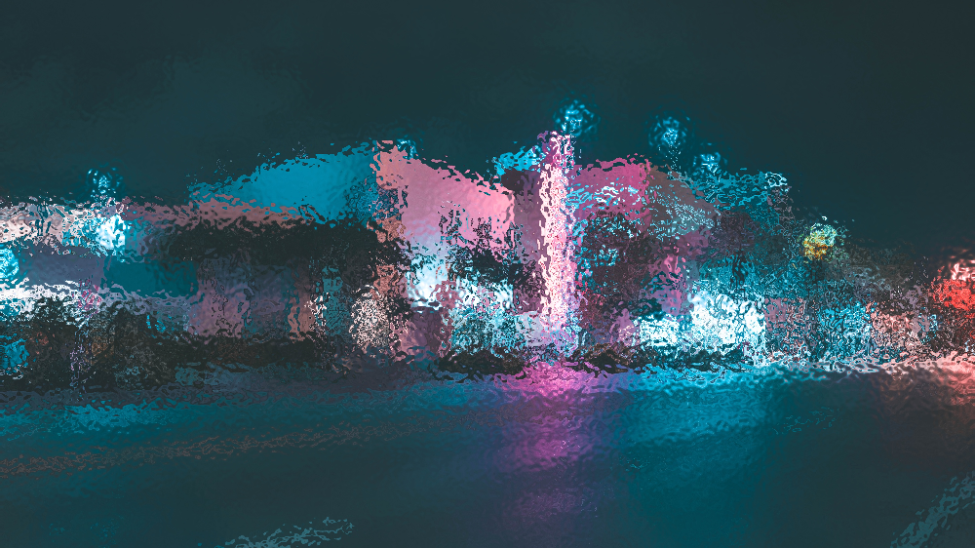
Conclusion and Results
It was a learning Experience, and the Process of Designing a Product and Finding a Solution to a Problem statement was understood. A Product was Designed and the Problem Statement was provided a viable solution to.
It was found that Each Tile can produce about 20W of power in a day. For one Streetlight we would just need 16 tiles

Slide 36
Bibliography
[1] LED Street Lights https://blogs.worldbank.org/energy/led-street-lighting-unburdening-our-cities [2] Electromagnetic Induction https://www.niehs.nih.gov/health/topics/agents/emf/index.cfm [3] Flywheel Battery https://www.youtube.com/watch?v=yhu3s1ut3wM [4] Pavegen https://pavegen.com/ [5] Inertia and Mass https://www.physicsclassroom.com/class/newtlaws/Lesson-1/Inertia-and-Mass

Slide 37
Prepared By:
Krishnaraj PT - Presentation, Calculations, Report
Tirth Thesiya –
Merits Demerits and Diagrams
Pranaav Suratwala –
Materials and Components
Devanshu Surana –
Theory and Idea Rack Analysis

Slide 38

Thanks for listening!

